Slide 1

Infosys Springboard Virtual Internship Project
InsurAI - Corporate Policy Automation
and Intelligence System
Presented By
Murali Krishna Nagiri
Varshith Vuppala
Likitha Markonda
Rochak Jain
Amrutha Agraharam

Slide 2
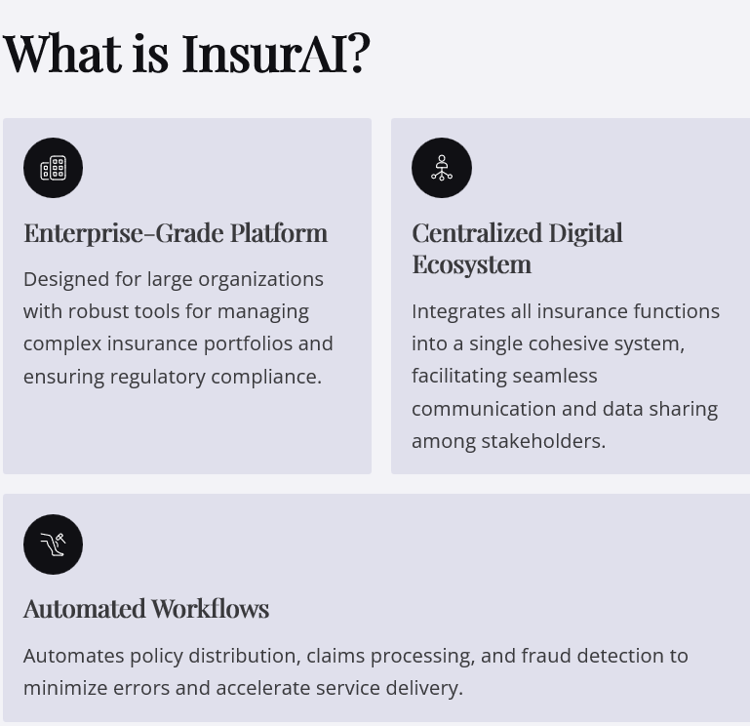
Project Overview: Revolutionizing Corporate Insurance Management
InsurAI is an enterprise-grade insurance management platform designed to streamline and automate corporate policy workflows. It provides intelligent tools for policy administration, risk assessment, claims processing, and compliance, enabling organizations to manage their insurance portfolios efficiently and insightfully.
Key Scope Areas:
Corporate-Focused: Tailored exclusively for corporate users, not individual policy buyers.
Role-Based Access: Supports secure access for Employees, Agents, HR Admin, and System Admin.
Comprehensive Functions: Includes policy renewals, claim approvals, tax compliance, reporting, fraud detection, and analytics dashboards.
Scalable Architecture: Built to support organizations of any size, from small businesses to large enterprises.

Slide 3
The Problem: Manual Insurance Management
Today's corporate insurance policy management is often a manual, HR-intensive process, leading to significant inefficiencies and risks for both companies and employees.
Delays in Claim Approval
Manual processing creates bottlenecks, slowing down critical claim resolutions.
Errors & Inaccuracies
Human data entry and verification are prone to mistakes, leading to disputes and rework.
Lack of Transparency
Employees often have no real-time visibility into their policy status or claim progress.
Increased Costs
High administrative overhead due to labor-intensive tasks drains resources.
Undetected Fraud
Manual systems struggle to identify and prevent fraudulent claims, leading to financial losses.

Slide 4
Challenges with the Existing System
The current, predominantly manual system for corporate insurance management is plagued by several critical challenges that impact efficiency, employee satisfaction, and financial security.
Paperwork & Manual Submission
Manual Verification
Employees are required to submit forms either physically or via email, leading to disorganized records and potential loss of documentation.
HR departments and insurance agents spend significant time manually verifying documents and confirming eligibility, a process ripe for human error and delays.
Delayed Claims & Lack of Tracking
Vulnerability to Fraud
Due to communication gaps and extensive paperwork, claims often experience significant delays. Employees lack the ability to track their claim status in real-time.
Without robust digital detection mechanisms, the existing system is highly susceptible to fraud, resulting in financial losses for the company.

Slide 5
Proposed System – InsurAI: Smart Automation & Intelligence
Our solution, InsurAI, is a web-based insurance management platform designed to automate key processes and leverage AI for enhanced intelligence and transparency.
Secure Role-Based Logins
1
Customized access for Employees, Agents, HR, and Administrators ensures data security and streamlined workflows.
Comprehensive Automation
Automatic policy renewals ensure continuous coverage.
2
Instant claim eligibility checks reduce processing time.
Auto-generated reports provide timely insights.
Automated tax rule application simplifies compliance.
AI & Analytics Power
3
Advanced fraud detection flags suspicious patterns and duplicate claims.
Predictive insights empower HR and Admins to make proactive decisions, chatbot for assistance.
Enhanced Transparency
4
Real-time claim and policy tracking for employees.
Automated notifications and reminders via email and SMS keep everyone informed.

Slide 6

InsurAI: Defined Roles for Seamless Operations
1
2
Employee
Agent
Register/Login
Manage employee queries
View policy details
Assist with claim submission
Submit claims and upload documents
Update availability
Track claim status
Access claim status
Query Agents for support
3
4
HR Admin
System Admin
Add/manage employees
Manage all user roles and permissions
Approve or reject claims based on fraud alerts
Configure system settings and tax rules
Manage policies and generate reports
Oversee system configuration and security
Monitor AI-generated fraud alerts
Generate comprehensive reports and analytics
AI & Analytics Layer (System Automation)
This foundational layer provides fraud detection (duplicate claims, suspicious patterns), predictive insights for HR/Admin on claim trends, real-time claim tracking, and automated notifications (email/SMS for status changes or fraud alerts).

Slide 7
Technology Stack: Robust & Scalable
InsurAI is built on a modern, flexible technology stack designed for performance, security, and future scalability, ensuring a reliable and efficient insurance management system.
Backend
Frontend
Database
Java Spring Boot, Spring Data JPA
React.js, CSS, Bootstrap
MySQL
Automation
Authentication
AI/Analytics
Spring Scheduler
JWT, Spring Security
Cohere API, Predictive Analytics, Rule-based Logic
File Storage
Notifications
Testing
Supabase S3
SMTP for Email/SMS
Postman
Future Deployment
Docker + Cloud (AWS/Azure)

Slide 8

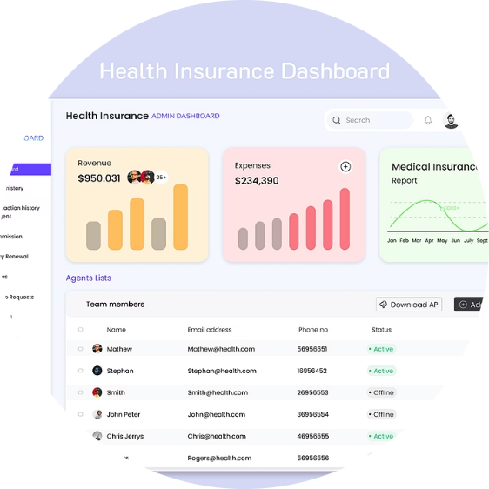
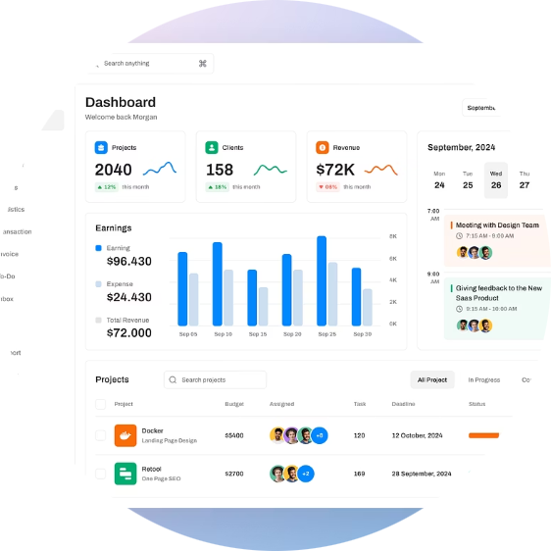
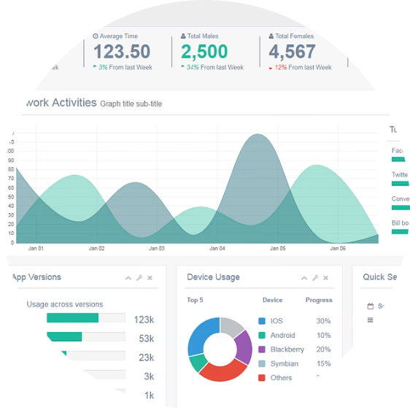
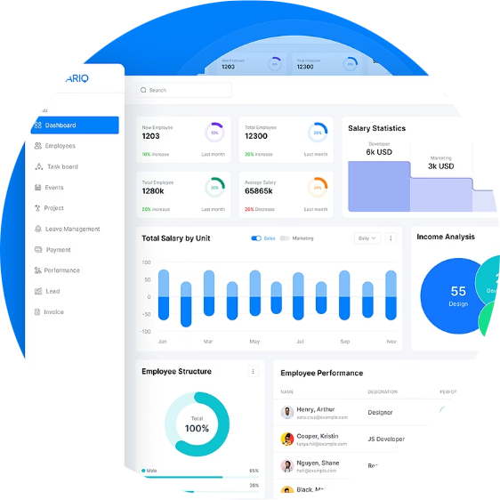
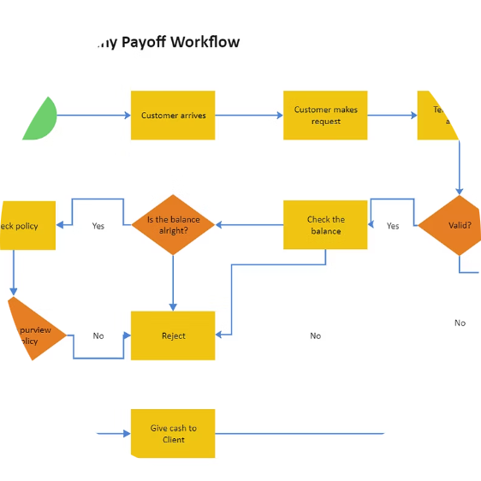
Core System Features: Driving Efficiency and Transparency
Authentication & Registration
Employee Portal
Agent Management
Secure login with JWT authentication.
Submit and track claims.
Agents register and update availability.
Role-based access for all users.
View policy details and benefits.
Efficiently handle employee inquiries.
Direct queries to Agents via chat or chatbot.
Admin Dashboard
Automation
HR Dashboard
Full control over user roles and permissions.
Auto-reminders for policy renewals and claim eligibility checks.
Manage employee queries and insurance data.
Configure tax rules and system settings.
Approve/reject claims with fraud alert integration.
Monitor fraud alerts and overall system health.
Configurable automation rules for notifications.
Automated report generation and distribution.
Generate scheduled and on-demand reports.

Slide 9






InsurAI Modules: A Holistic Approach
Login & Registration
Policy Management
Secure JWT authentication.
Add, update, and view company policies.
Role-based access control.
Employee access to policy details and PDFs.
Employee self-registration.
Claim Management
Agent Management
Employee claim submission and document upload.
Track agent availability.
Automated eligibility and fraud checks.
Manage employee queries and interactions.
HR review and approval/rejection.
Real-time status updates.
Admin Dashboard
Reports & Analytics
Comprehensive user role and permission management.
Automated report generation (PDF/Excel).
Fraud alert and system health monitoring.
AI-powered insights and predictive analytics.
Automation rule configuration.
Visual dashboards with real-time metrics.

Slide 10
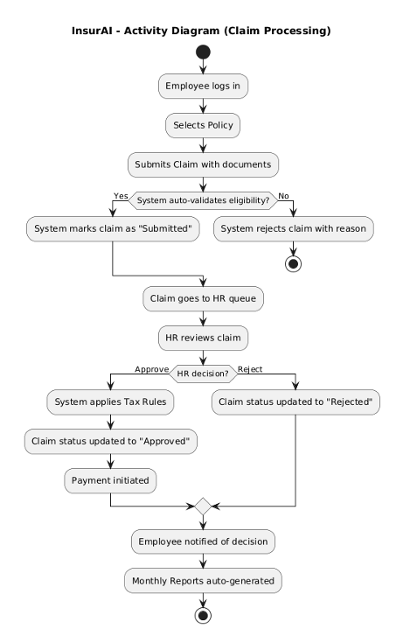
Streamlined Workflow Example
Admin Initiates User Setup
Admin logs in and registers HR and Agent profiles.
HR & Agent Login
HR and Agents log into their respective portals to manage operations.
Employee Onboarding
Employee self-registers or logs in to access insurance services.
Policy Review & Agent Support
Employee views policies and engages with Agents for inquiries.
Claim Submission
Employee submits claims, attaching necessary documents.
Automated Fraud Detection
System automatically checks for fraudulent patterns.
HR Review & Decision
HR reviews the claim and makes an approval or rejection decision.
Reporting & Analytics
HR, Admin, and Agents generate comprehensive reports.

Slide 11
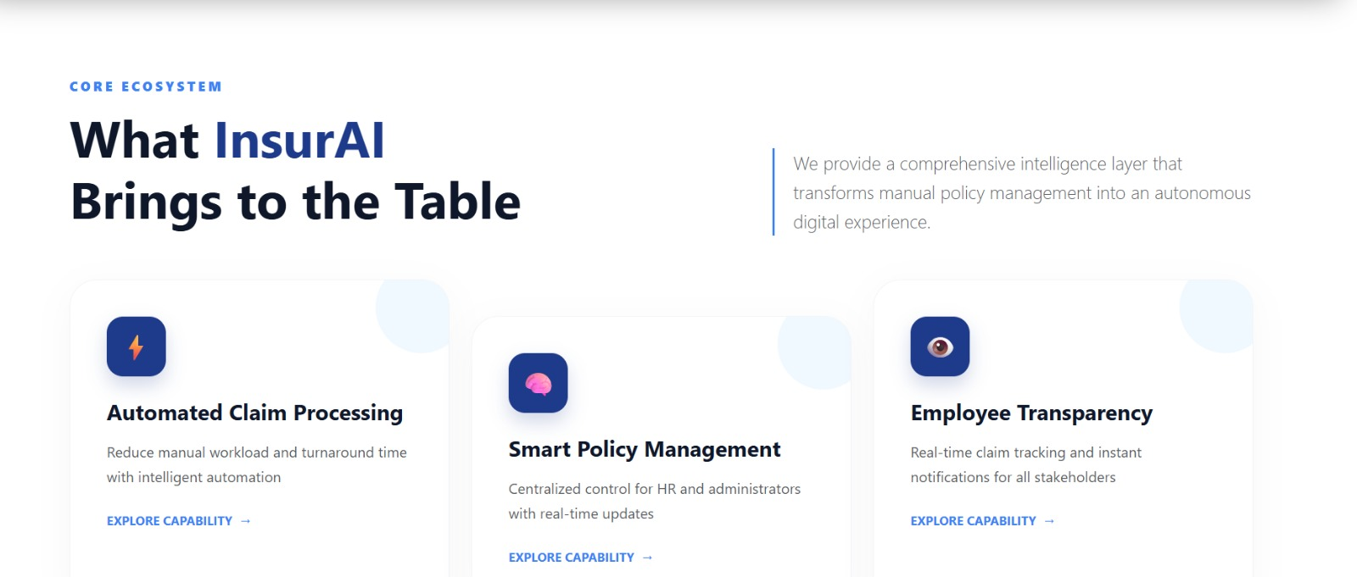
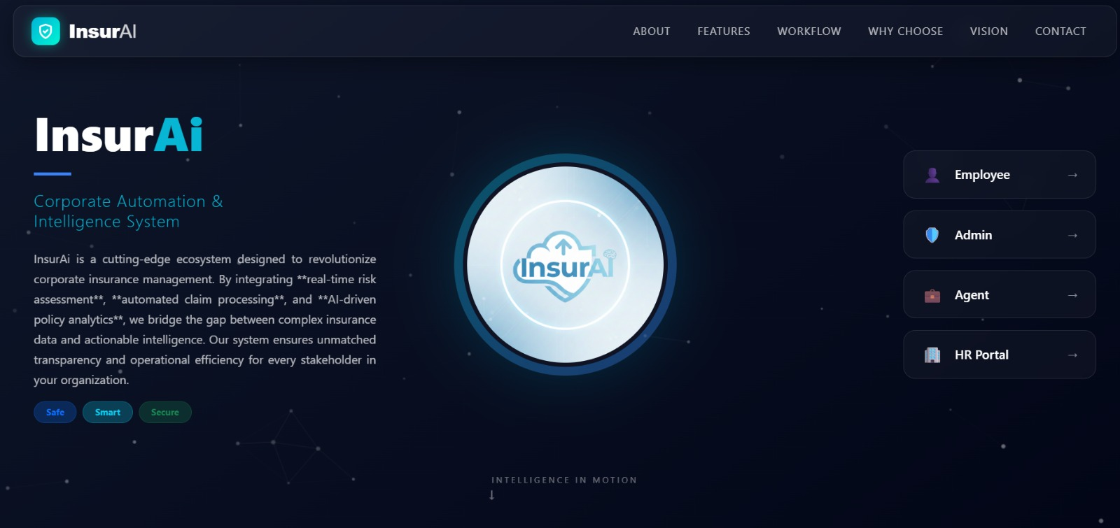
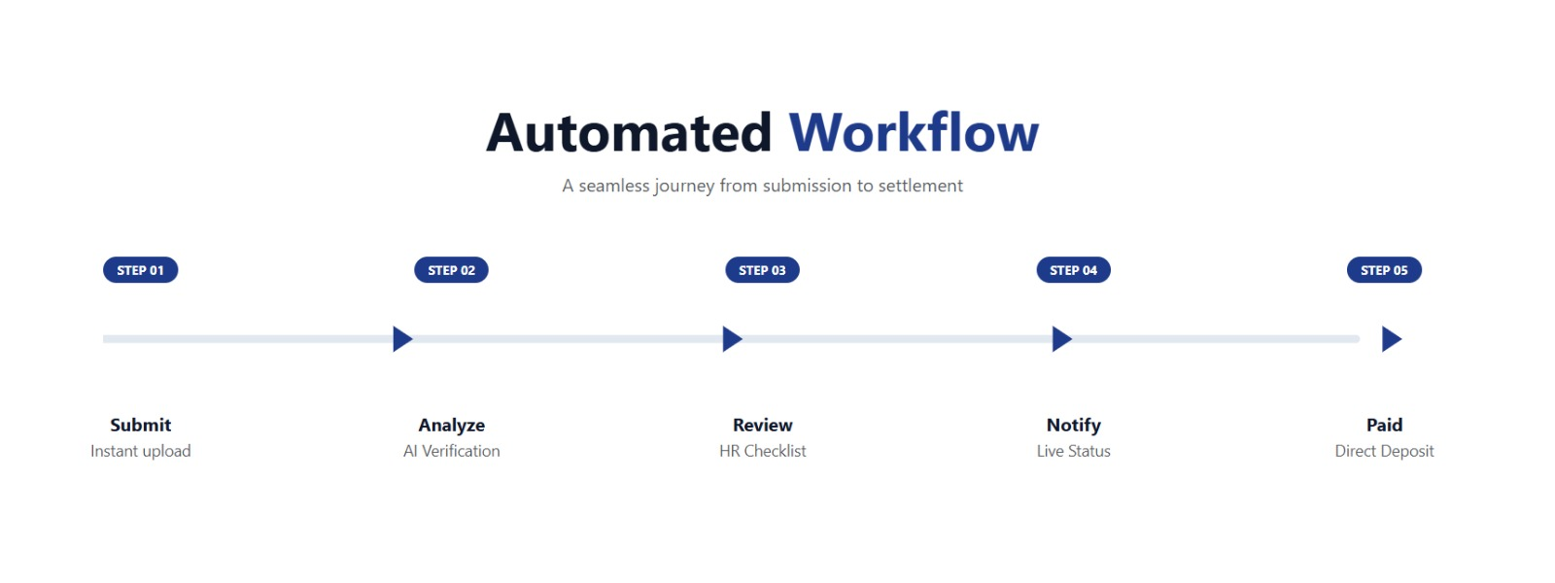
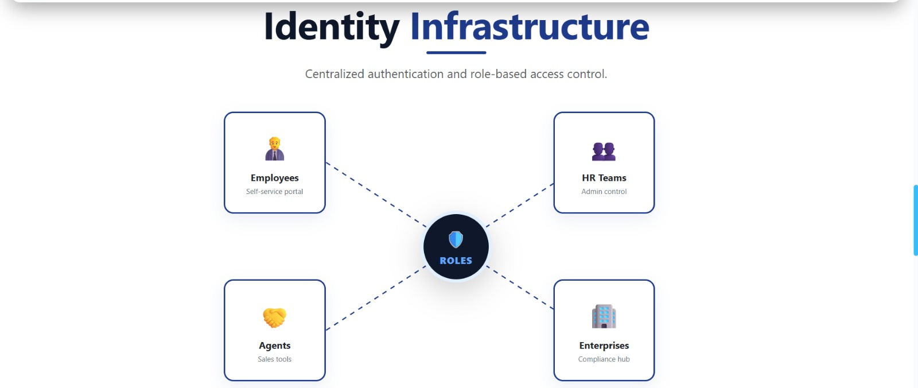
Screenshots: The UI and Outputs

Slide 12
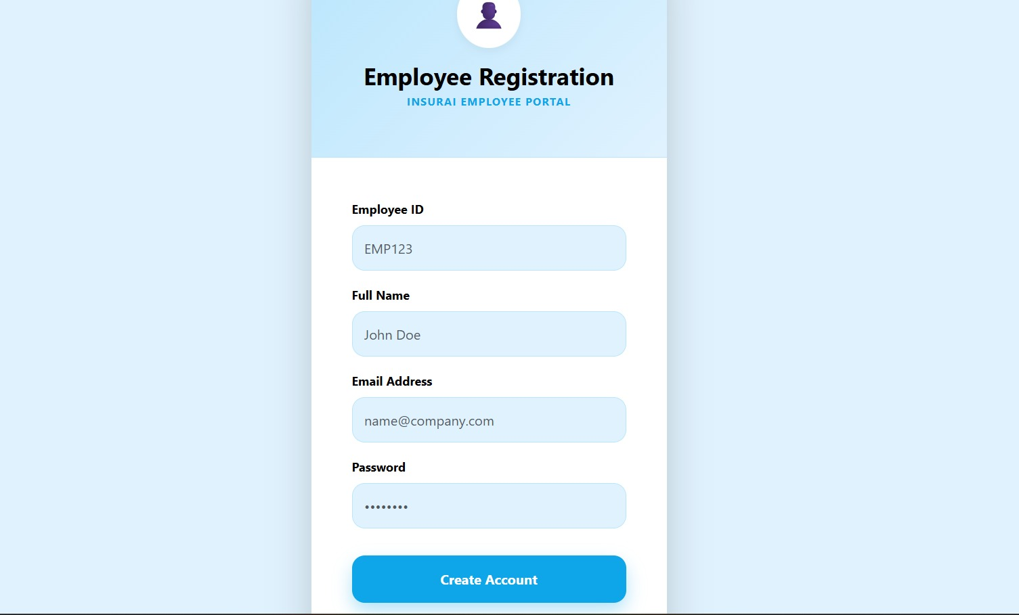
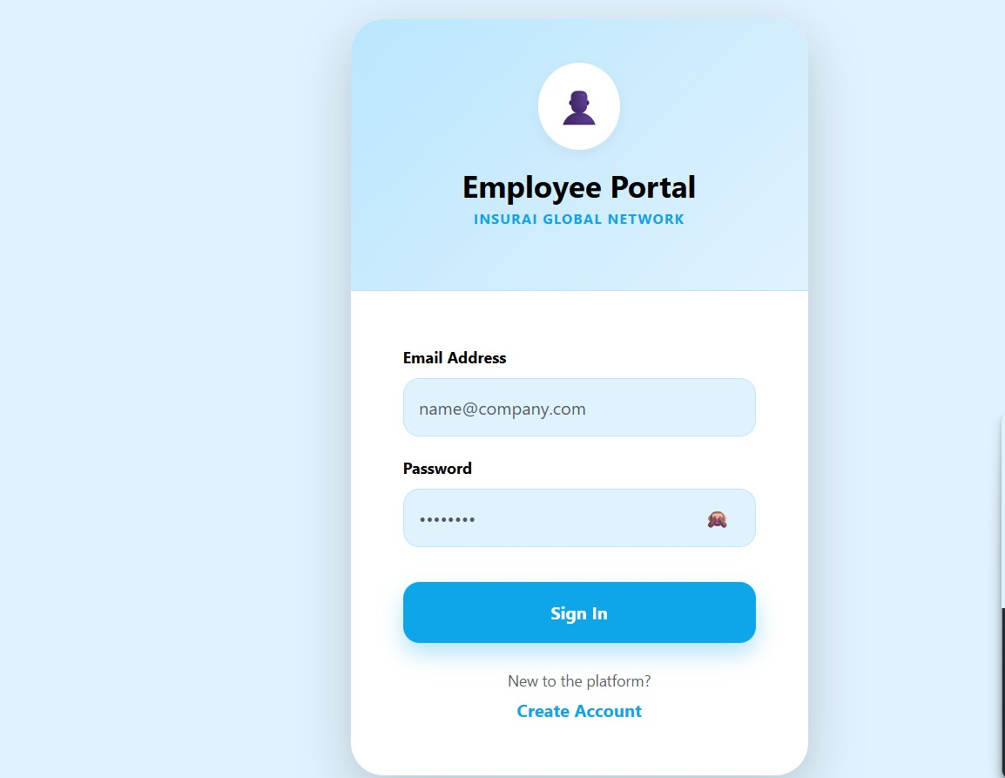
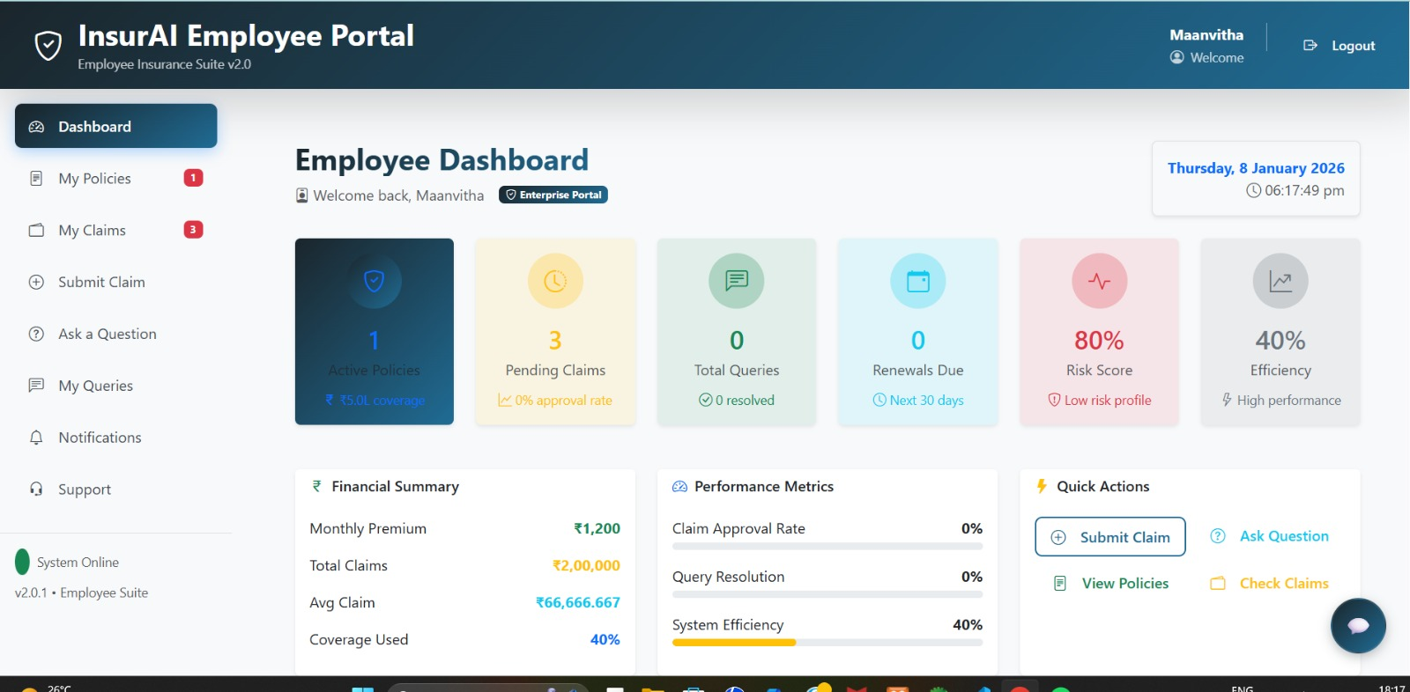
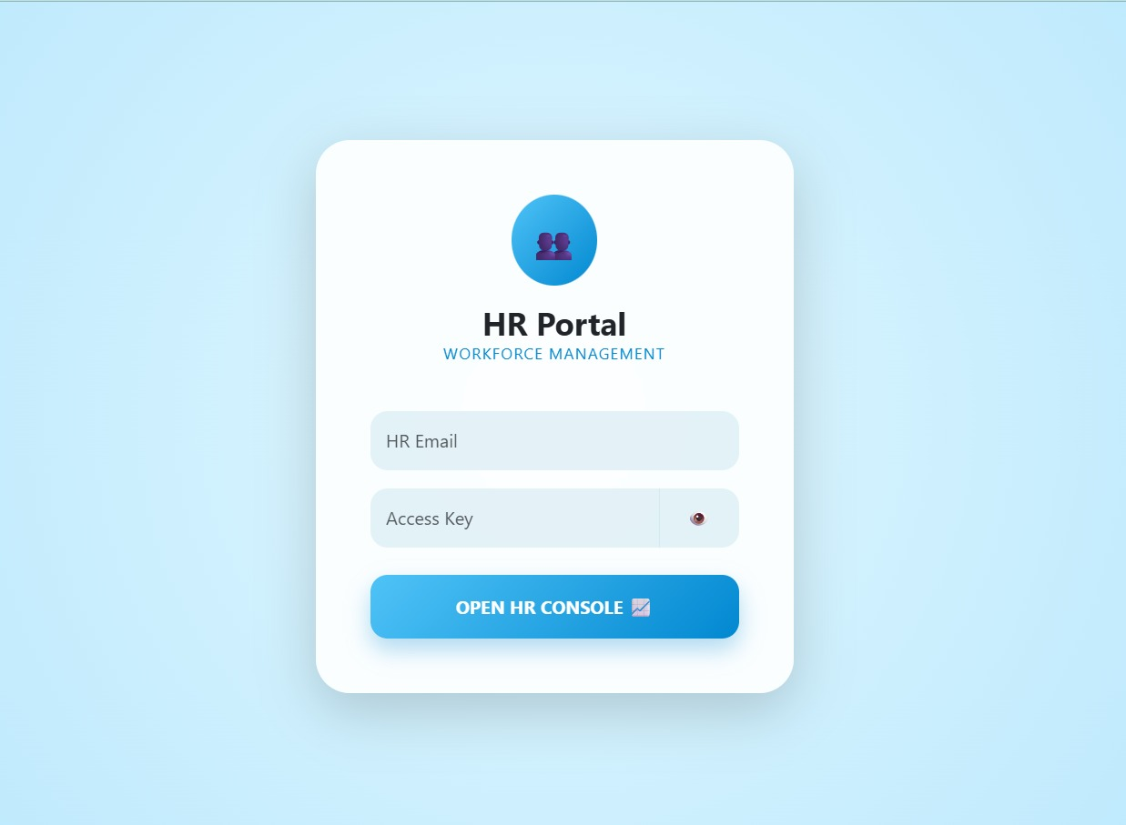
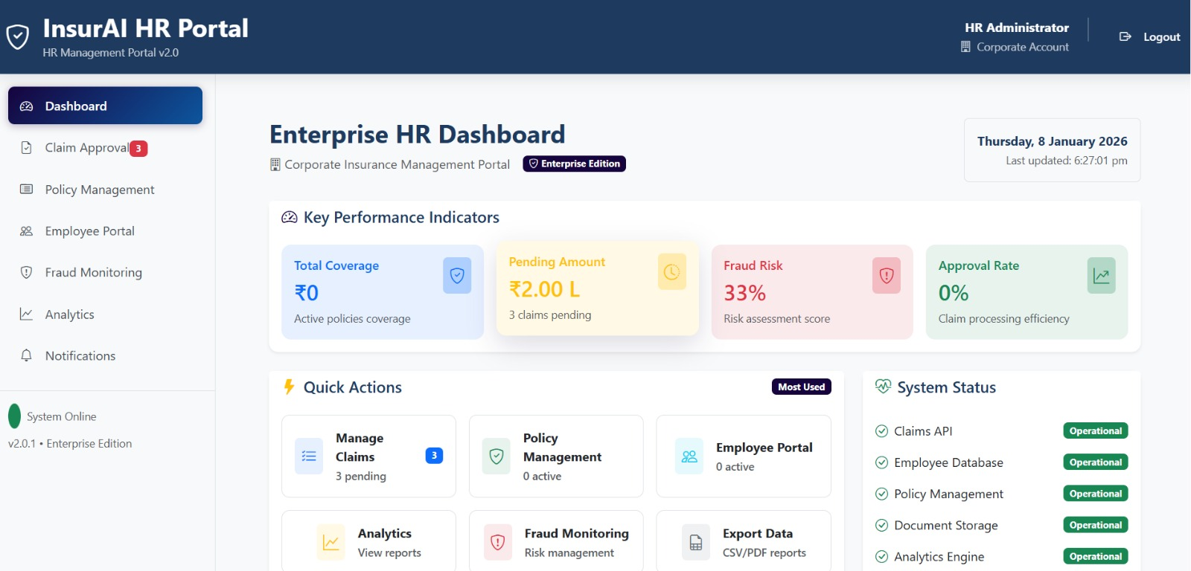

Slide 13
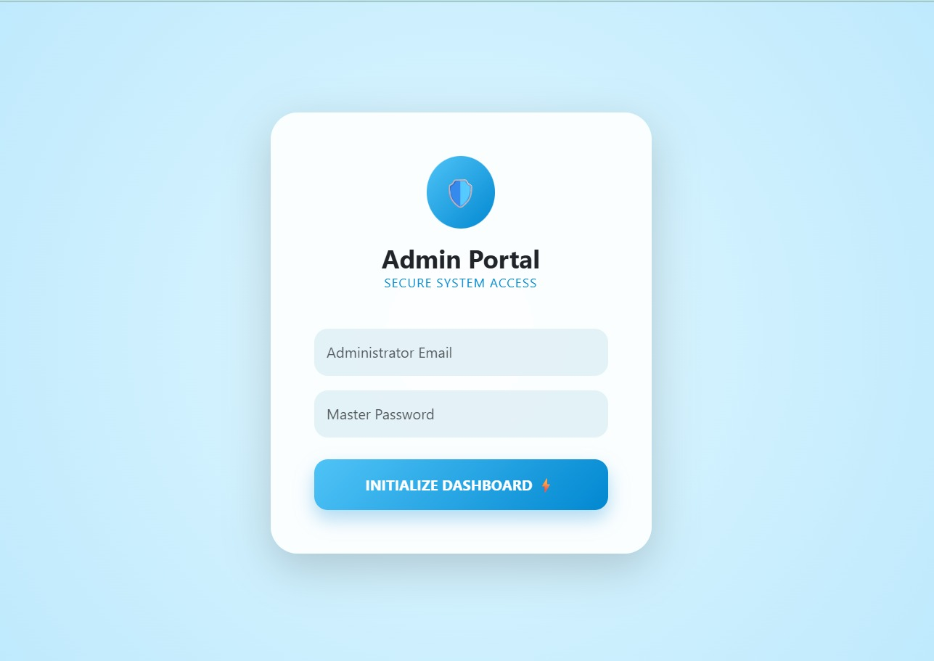
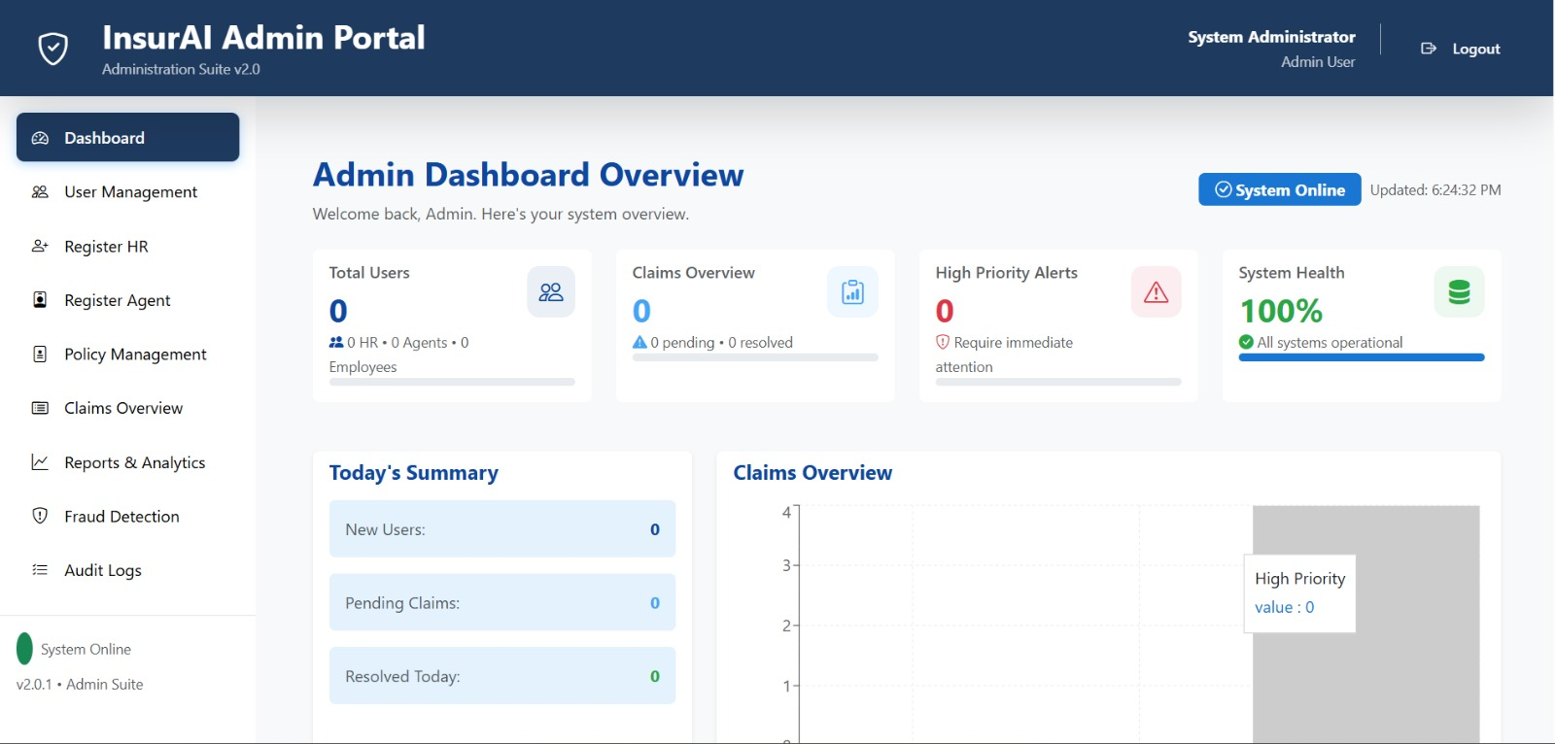
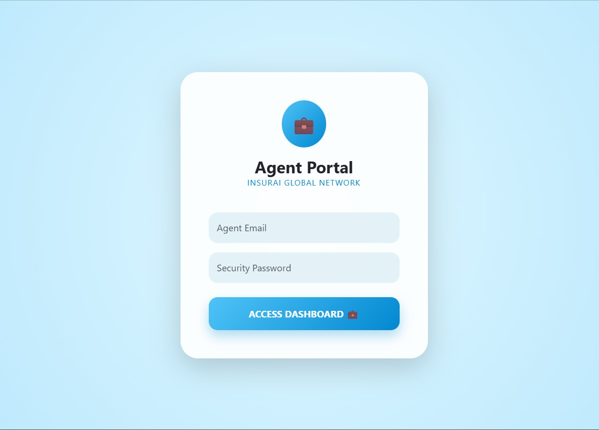
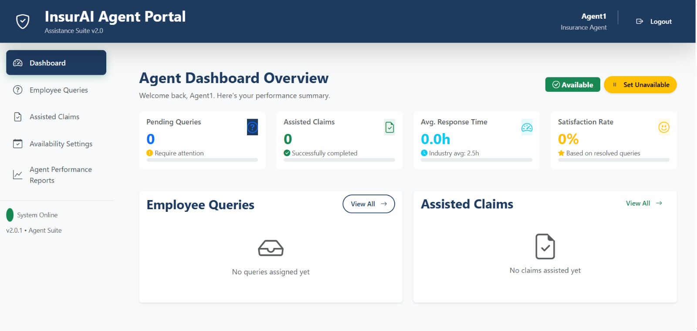

Slide 14
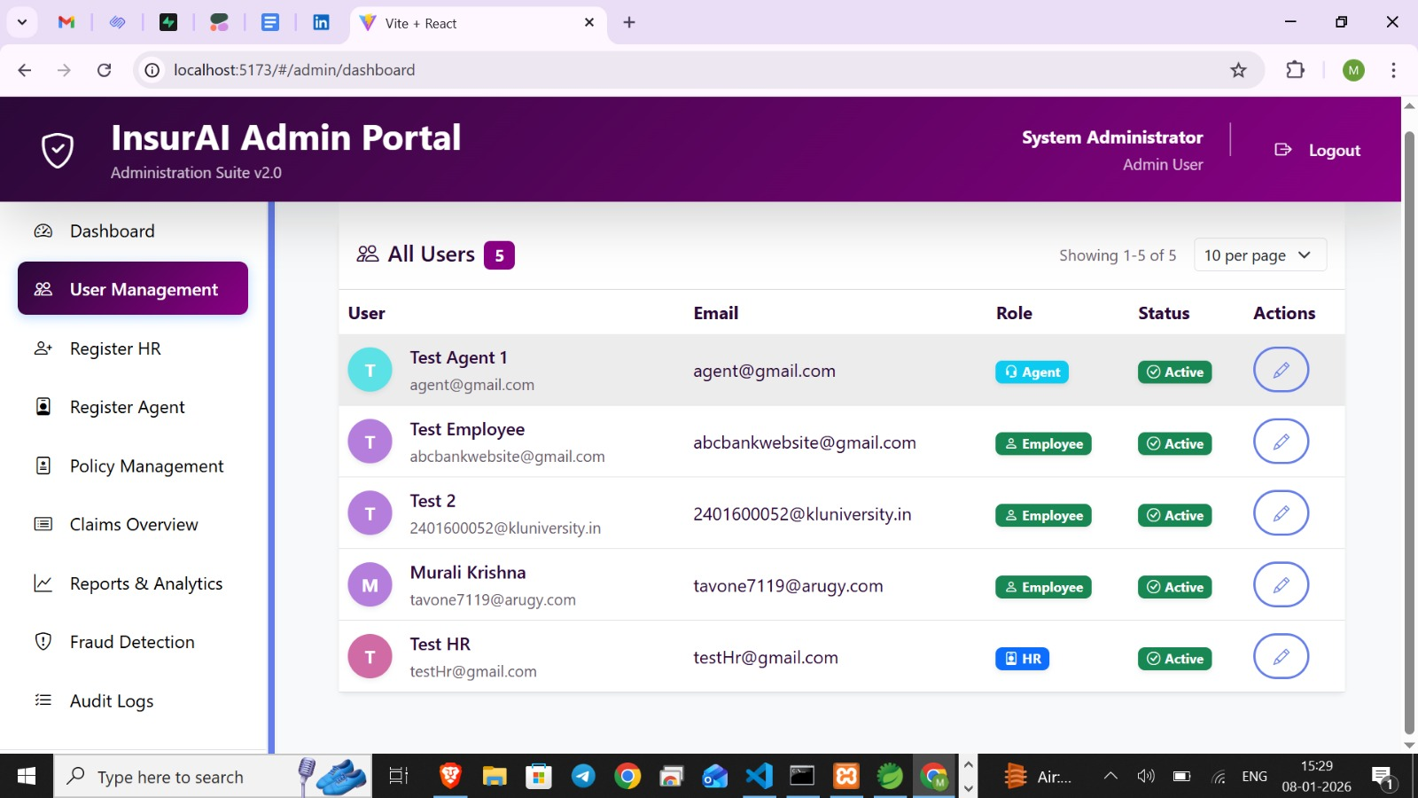

Slide 15
InsurAI: Benefits, Current Status & Future Vision
Key Advantages
Current Limitations
Future Scope
For Employees: Faster claims processing, enhanced transparency, real-time updates on claim status.
Web-Only Platform: Currently accessible only via web browsers; dedicated mobile apps are planned.
Mobile Apps: Development of native Android and iOS applications for employees.
For HR: Significantly reduced administrative workload, efficient automated reporting capabilities.
AI Fraud Detection: Initial iteration is rule-based; future enhancements will integrate advanced ML models for greater accuracy.
Enhanced Integration: Seamless integration with insurance companies and hospitals for direct data exchange.
For Admin: Comprehensive control over the system, advanced fraud detection, and compliance assurance.
Blockchain Technology: Exploring blockchain for secure, immutable claim history and enhanced data integrity.
External Integrations: Direct integration with external insurance providers is pending development.
For the Company: Measurable cost reductions, a highly scalable and trusted insurance management solution.
Connectivity Requirement: Requires continuous internet access for full functionality.
Cloud Deployment: Transition to a robust cloud infrastructure for large-scale, high-availability usage.

Slide 16

Conclusion: InsurAI – Your Strategic Partner for Modern Insurance Management
InsurAI emerges as a comprehensive, enterprise-grade solution poised to revolutionize the corporate insurance claims process. By leveraging advanced technology, it delivers substantial value across the organization:
Enhanced Efficiency: Streamlines claims management, significantly reducing workload for HR and admin staff.
Unparalleled Transparency: Offers real-time updates and clear visibility for employees, fostering trust and satisfaction.
Robust Control & Compliance: Provides administrators with full oversight, advanced fraud detection, and ensures regulatory adherence.
Strategic Growth: Delivers cost savings, scalability, and a trusted platform, supporting the company's long-term objectives.
Future-Proofing: With planned mobile integrations, advanced AI capabilities, and blockchain security, InsurAI is designed for continuous evolution and adaptation to emerging needs.
InsurAI is more than just a tool; it's a strategic partner for businesses aiming for a smarter, more secure, and employee-centric future in insurance claims management.

Slide 17

THANKYOU

